Slide 1
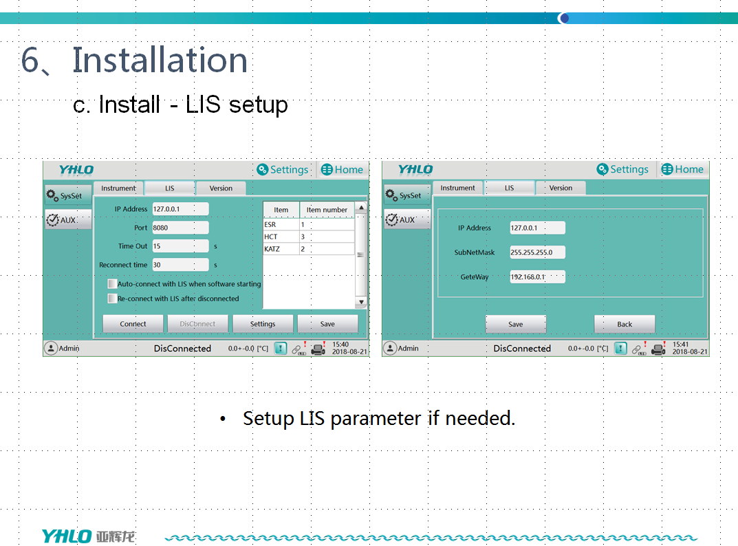

Slide 2
Permission level | User name | Password | Operating authorization
User | User | user | Cycle, random, QC, results
Admin | Admin | admin | Cycle, random, QC, results, settings
*대소문자 구분해서 입력

